Slide 1
Welcome to R Database Workshop
Joseph Rudolf
API R 2024
Notes:
Welcome to the 2024 API R Database Workshop!

Slide 2
Course Introduction
Notes:
The following slides include a short introduction to the workshop.

Slide 3
Goal
Build practical skills to make database connections and query data in R
Notes:
This workshop is intended to provide an introduction to working with databases in R.
This is an intermediate course which assumes users have completed a basic course including familiarity with reproducible data analysis in Quarto and the Tidyverse package.

Slide 4
Schedule
Time | Session | Instructor
1:15 – 2:00 PM | Database Concepts Demystified | Joseph Rudolf MD
2:00 – 2:45 PM | Databases with R: A Marriage Made in the Tidyverse | Patrick Mathias MD PhD
2:45 – 3:05 PM | Refreshment Break
3:05 – 3:50 PM | Joining Forces: Data Merging Techniques in R | Amrom Obstfeld MD PhD
3:50 – 4:00 PM | Refreshment Break
4:00 – 4:45 PM | Getting Your Feet Wet with Clinical Research Data with REDCap and R | Stephan Kadauke MD PhD
Notes:
Here is a schedule of the presentations for today.
We will have a couple breaks throughout the afternoon.
Individual presentations may run a bit under or over time but we expect to end on time at 4:45PM.

Slide 5
Who Are We?
Notes:
We will take a few minutes to introduce ourselves and we would like to get to know you too.

Slide 6
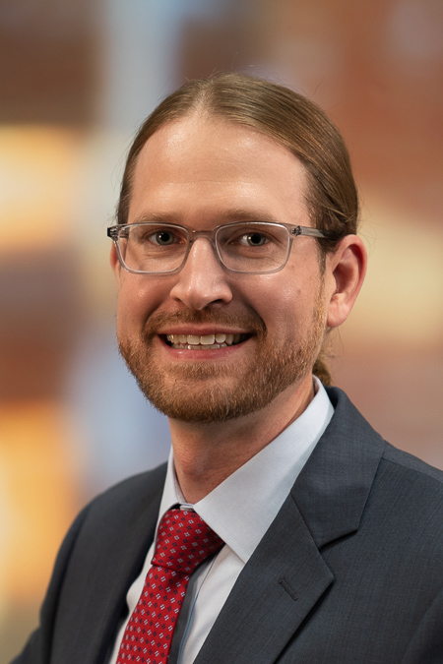
Joseph Rudolf
Assistant Professor, Department of Pathology, University of Utah Medical School
Medical Director, Automated Core Laboratory, ARUP Laboratories
Medical Director, Clinical Informatics, ARUP Laboratories
Notes:
Joseph Rudolf, MD is the medical director for the automated core laboratory at ARUP Laboratories in Salt Lake City, Utah. His clinical and research interests focus on the intersection of informatics and clinical operations including clinical decision support, utilization management, and reporting and analytics. He is also passionate about clinical process improvement and initiatives to support quality and safety.

Slide 7
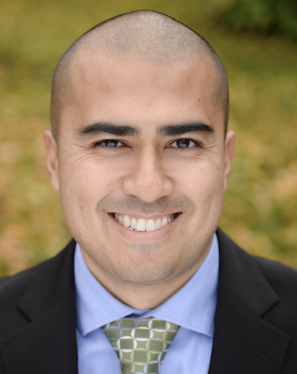
Patrick Mathias
Associate Professor, Department of Laboratory Medicine and Pathology
University of Washington School of Medicine
Associate Medical Director, Laboratory Medicine and Pathology Informatics
Vice Chair of Clinical Operations
Notes:
Patrick Mathias, MD, PhD, is the Associate Medical Director of the Informatics Division in the Department of Laboratory Medicine at the University of Washington School of Medicine. His interests include developing data science and analytics as a core competency to improve clinical lab operations and laboratory stewardship, and applying clinical informatics approaches to mitigate laboratory-associated diagnostic errors. He is interested in developing and improving programming and data science education across all levels of pathology practice.

Slide 8
Amrom Obstfeld
Associate Professor of Clinical Pathology and Laboratory Medicine
University of Pennsylvania Perelman School of Medicine
Director of Pathology Informatics
Children's Hospital of Philadelphia
Notes:
Amrom Obstfeld MD, PhD is the Medical Director of the Division of Pathology Informatics at Children’s Hospital of Philadelphia. In this role he leads the development of analytic tools to aid in quality management and operations, interfaces with other groups throughout the hospital on informatics initiatives. He also designs and implements informatics educational experiences for pathology trainees and faculty at the University of Pennsylvania.

Slide 9
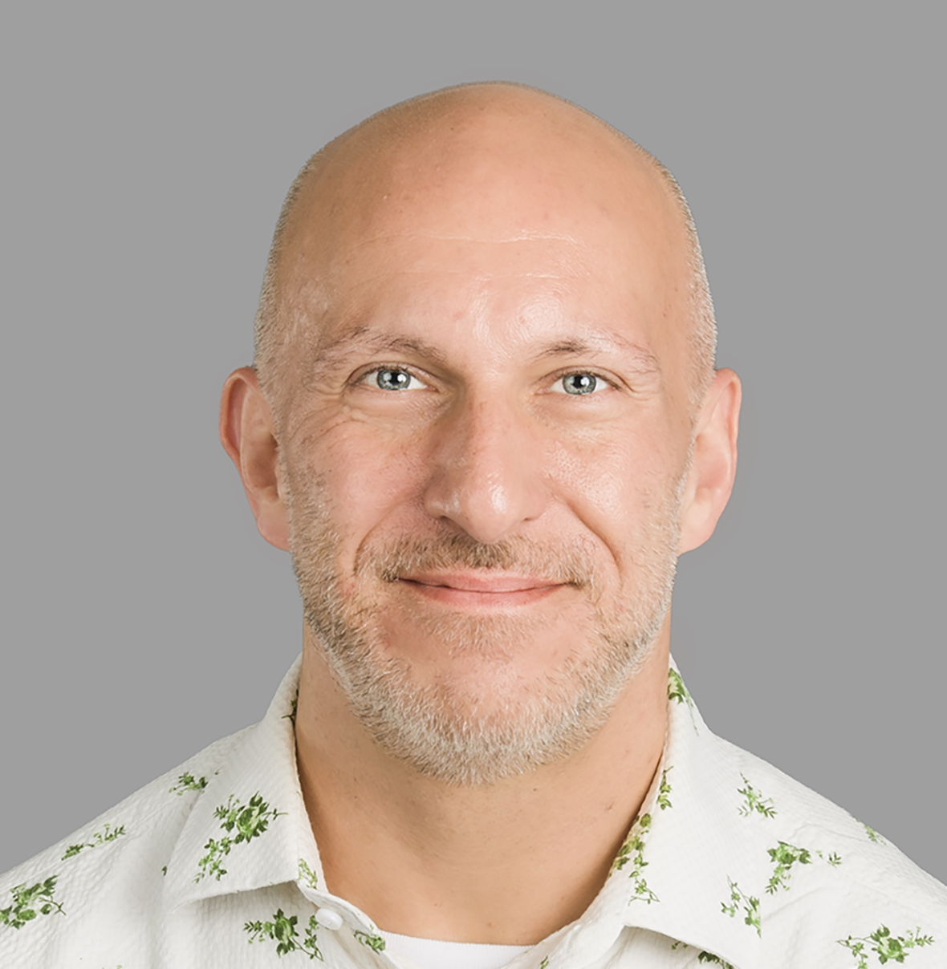
Stephan Kadauke
Assistant Professor of Clinical Pathology and Laboratory Medicine
University of Pennsylvania Perelman School of Medicine
Associate Director of the Cell and Gene Therapy Laboratory
Medical Director of Cell and Gene Therapy Informatics
Children's Hospital of Philadelphia
Notes:
Stephan Kadauke, MD, PhD is an Assistant Professor of Pathology and Lab Medicine at the Children’s Hospital of Philadelphia where he is the Associate Director of the Cell and Gene Therapy Lab. He leads the Cell and Gene Therapy Informatics group which builds and deploys predictive models and other data products for the care of children who receive bone marrow transplants and other cell therapies.

Slide 10
Workshop Workflow
Notes:
Let’s also take a couple minutes to go over the workshop workflow.

Slide 11
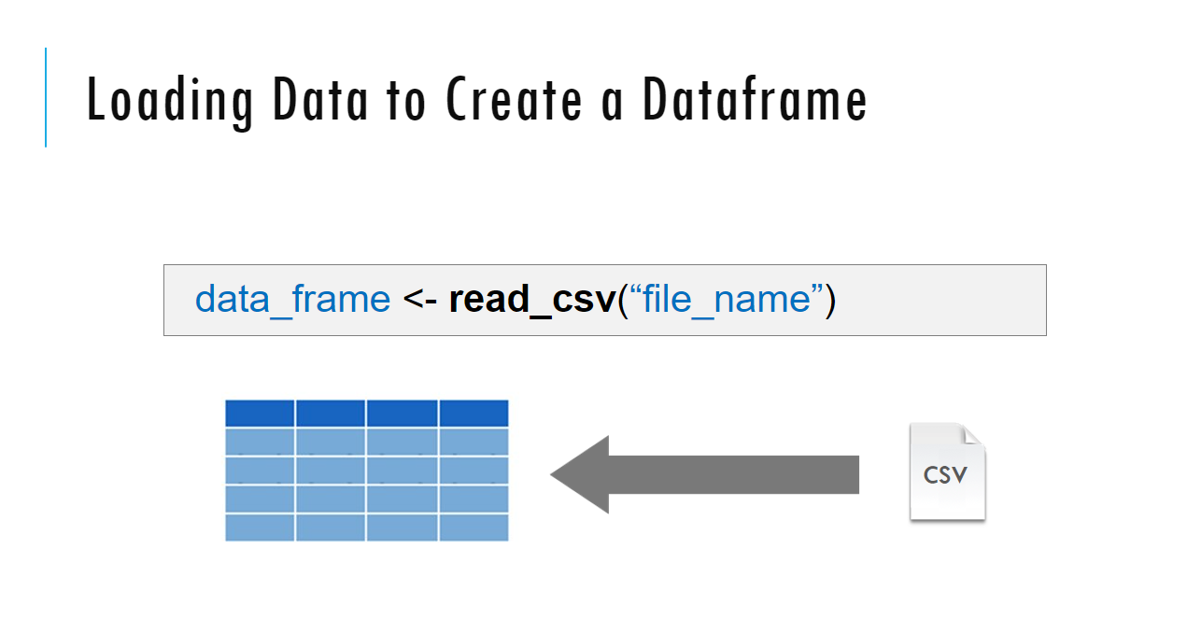
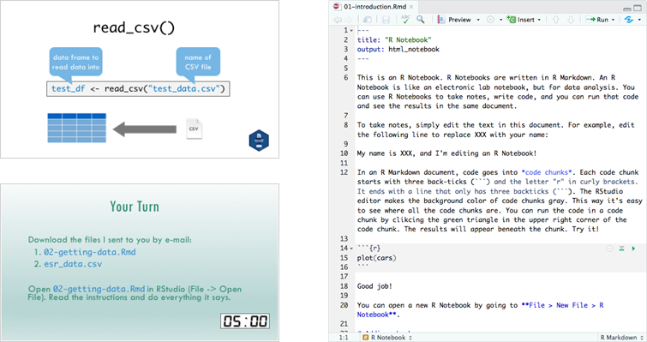
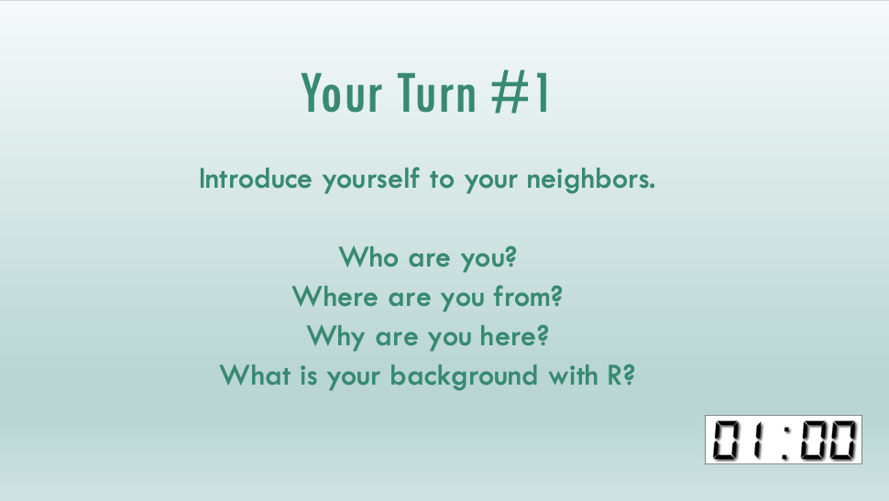
Sessions
Notes:
If you have participated in one of our introductory courses this workflow may be familiar to you.
The course content consists of three activity types (and we will move back and forth between them throughout the day):
-Didactic slides that introduce important programming concepts
-Interactive exercises (“Your Turns”) where you will practice programming skills
-Live coding by instructors where we will review “Your Turn” answers
And repeat!

Slide 12
Your Turns
Too Hard?
Ask a Neighbor
Ask an Instructor
If you're not done
Don’ t worry
Exercises will be reviewed
Fill in along with Presenter
All answers are in the files in the answer folder
Too Easy?
Help your Neighbor
Play!
Modify the code – see what happens
Notes:
A bit more about the “Your Turns”.
The your turns provide your turn to learn and an opportunity to teach each other.
Don’t hesitate to reach out to your neighbor or a course instructor if you have a question.
If you finish the exercise early, experiment with the code and be a resource for your neighbors.
When the timer ends, stop working on the exercise and we will review the solution as a group.
Solutions are also contained in the GitHub repository so you will have access to them after the the workshop.

Slide 13
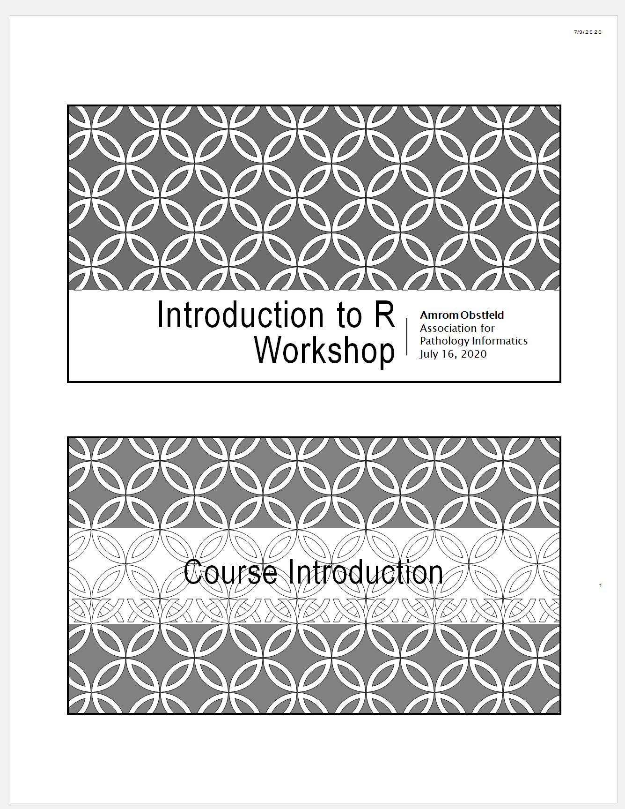
Workshop Coursebook
Print out of all slides
Appendix
Cheat sheets
Useful resources
Notes:
The coursebook has all the session powerpoint slides as well as an appendix that has some additional resources
Cheat sheets are concise one or two page documents that you can use as a quick reference. we'll be referring to these during the sessions. They are also available online at the Posit website.

Slide 14
Who Are You?
Notes:
So, now that you've learned a bit about us and how this is all going to work, let's find out a little bit about you

Slide 15
Your Turn #1
Introduce yourself to your neighbors.
Who are you?
Where are you from?
Why are you here?
What is your background with R?
Notes:
Please introduce yourself to us and your neighbors.

Slide 16
Final Tips
The best way to learn to code is by doing
Practice is key!
Notes:
The best way to learning to code is by doing and practice is key.
So with that in mind, let’s jump into the workshop!!

